Slide 1

KNN Algorithm Visualization
Nov 21st, 2024
Applied to Iris Dataset
Team 3Cs
Team Member:
Erdun E
Xinyu Wang
Fengkai Liu

Slide 2
Overview
The Overview of Project and kNN Algorithm
The History of kNN Algorithm
kNN Examples
Project Implementation (3 parts)
Project Demo
Reflection (3 parts)

Slide 3
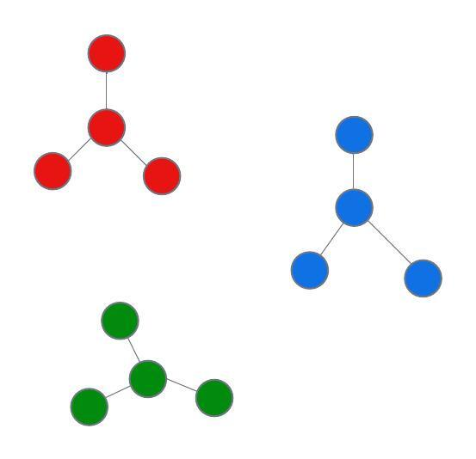
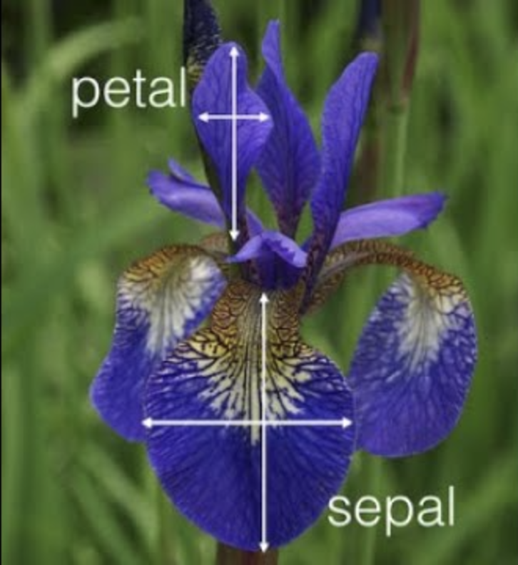
Project and kNN Algorithm Overview
This final project implements the K-nearest neighbor algorithm (kNN) algorithm using the Iris dataset to train the program and predict user-input data points.
A machine learning algorithm
Compare the distance of one data point with a set of data points and make predictions based on such comparison.
Data points within the same category, with similar qualities, or within the same class
Datasets
Supervised learning algorithm
Pattern Recognition, categorization, or classification.
[Anand Manivannan]. (2024, November 20). IRIS DATA SET EXPLANATION [Video]. YouTube. https://www.youtube.com/watch?v=Orz8dlCjnnk

Slide 4
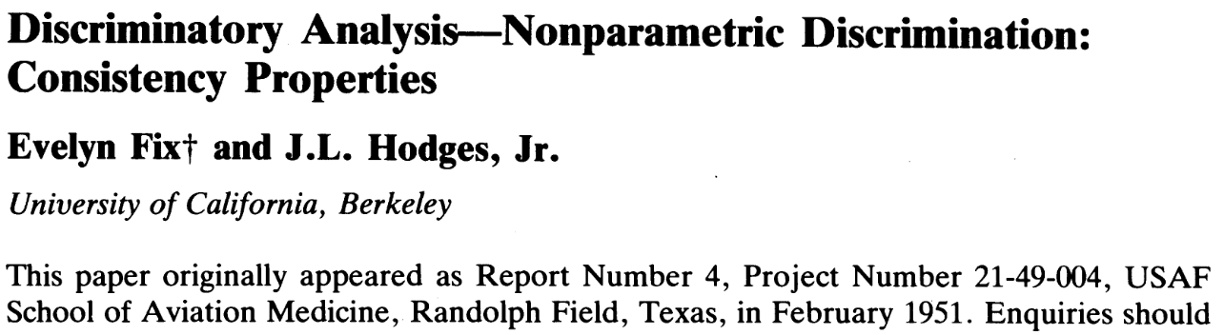
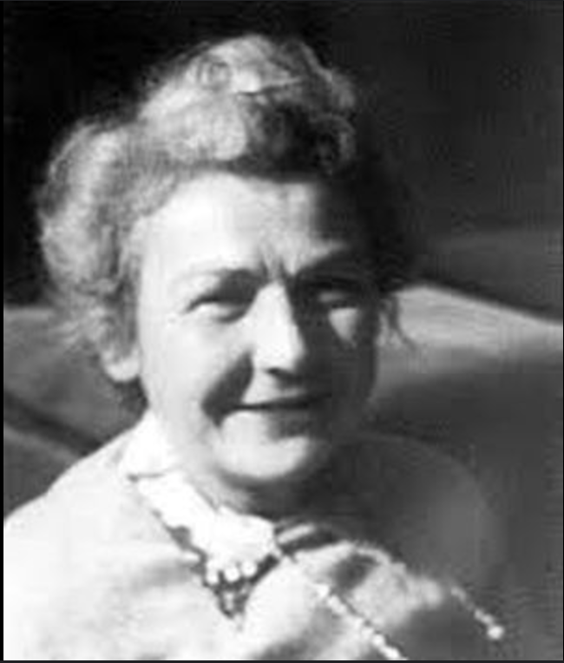
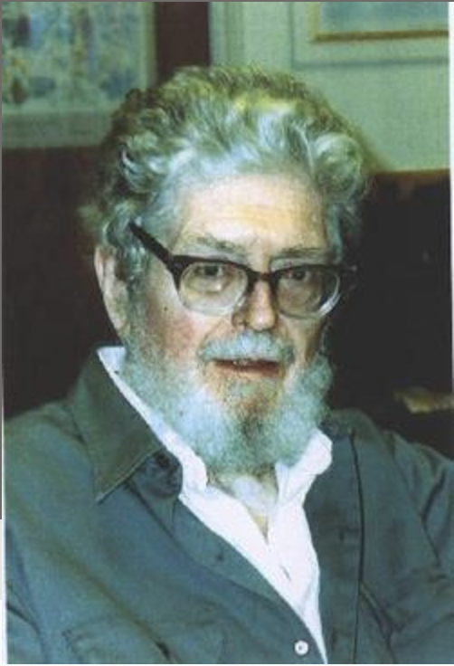
Some Background Knowledge
In 1951, Evelyn Fix and J. L. Hodges, Jr. from UC Berkeley developed this algorithm
Solve the discrimination problem
Choose a positive integer k that is large but small compared to the sample size;
Specify a matrix, such as Euclidean distance;
Find k values from the pooled samples which are nearest to the targeted distributed space z.
UC Regents (n.d.). Evelyn Fix. UCB Statistics. Retrieved December 20, 2024, from https://statistics.berkeley.edu/about/biographies/evelyn-fix
Find a Grave (n.d.). Evelyn Fix. Retrieved November 20, 2024, from https://www.findagrave.com/memorial/43536381/joseph-lawson-hodges

Slide 5
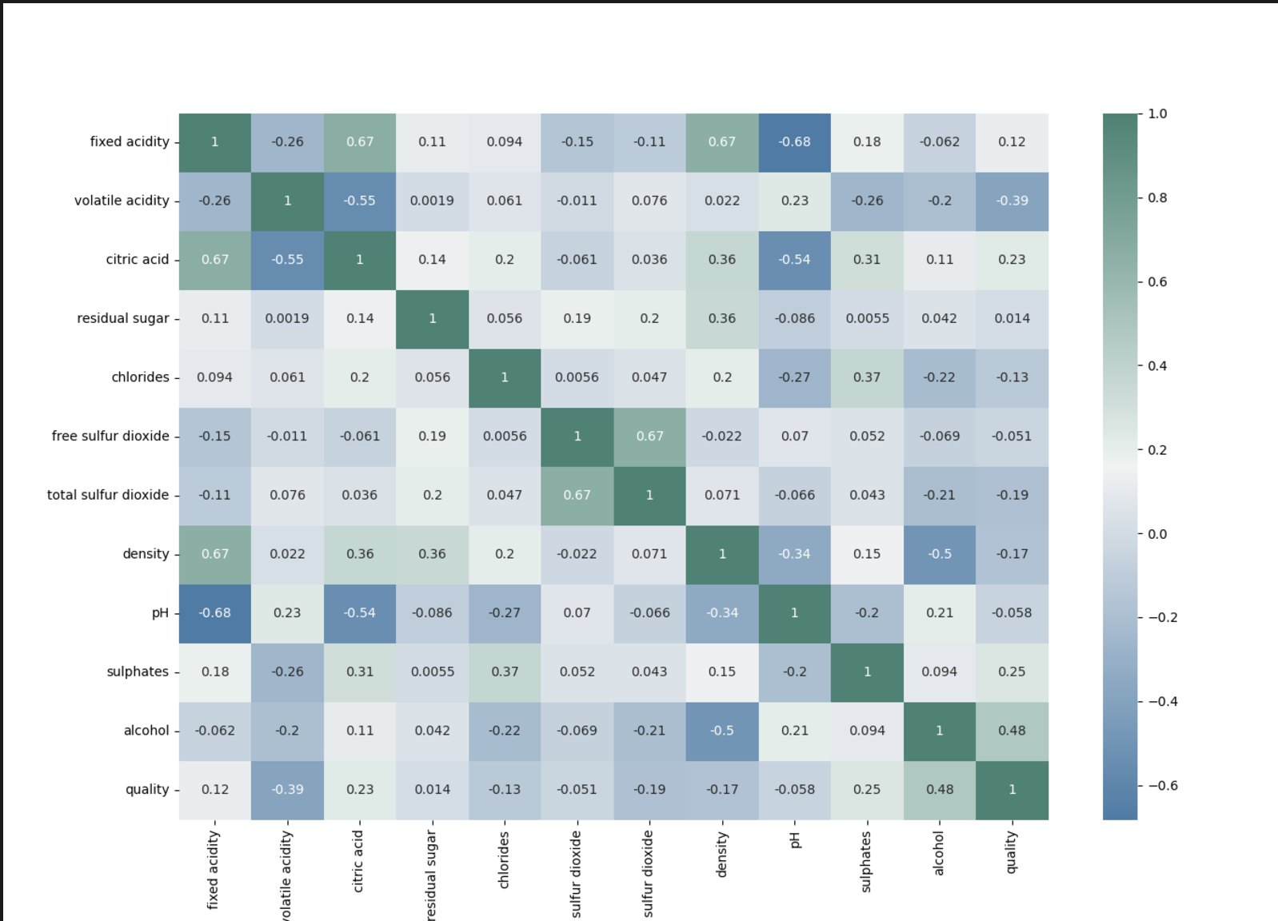
kNN Examples
Wine Quality Classification System
Wine quality prediction could be affected by 11 factors such as acidity, residual sugar, pH, and alcohol content.
To test the quality of a wine sample, we can use an existing wine quality dataset to train a kNN model and based on the accuracy of the classification fine-tune the model until it reaches an optimum k-value that yields the best accuracy (Lavasani, 2024).
Polinowski, M. (n.d.). SciKit Wine Quality. Retrieved November 21, 2024, from https://mpolinowski.github.io/docs/IoT-and-Machine-Learning/ML/2023-01-30-predicting-wine-quality/2023-01-30/

Slide 6
Our Project
DataProcessorModule
KnnAlgorthmModule
Visualizer Module

Slide 7
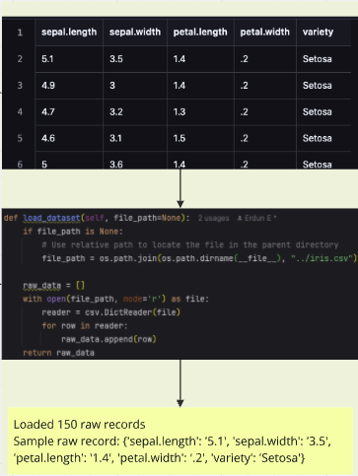
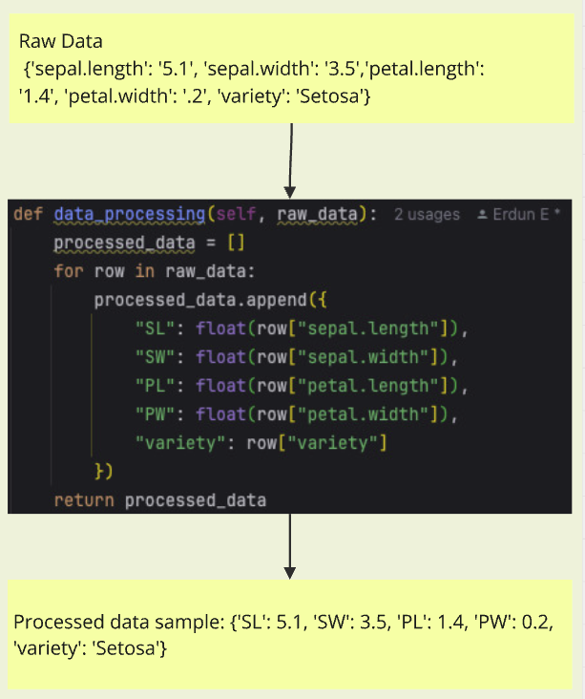
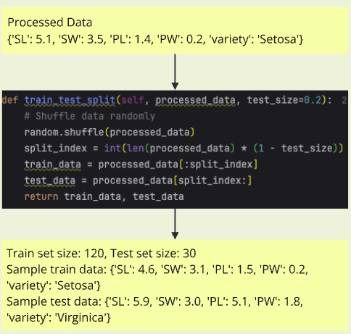
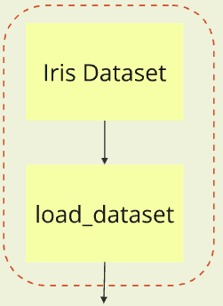
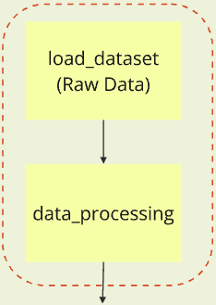
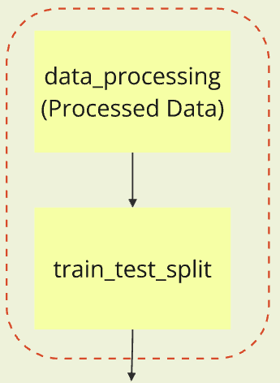
DataProcessorModule
data_processing
train_test_split
load_dataset
DataProcessorModule
data_processing
train_test_split

Slide 8
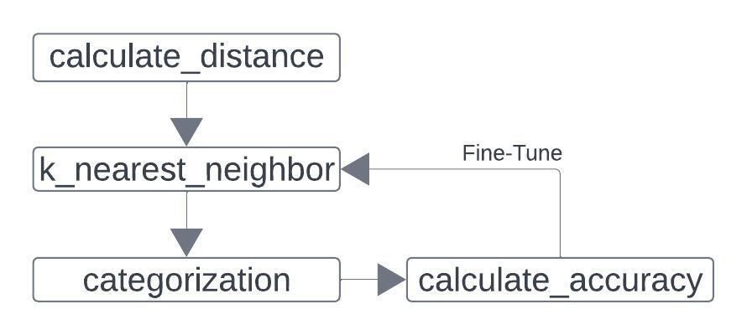
KnnAlgorthmModule

Slide 9
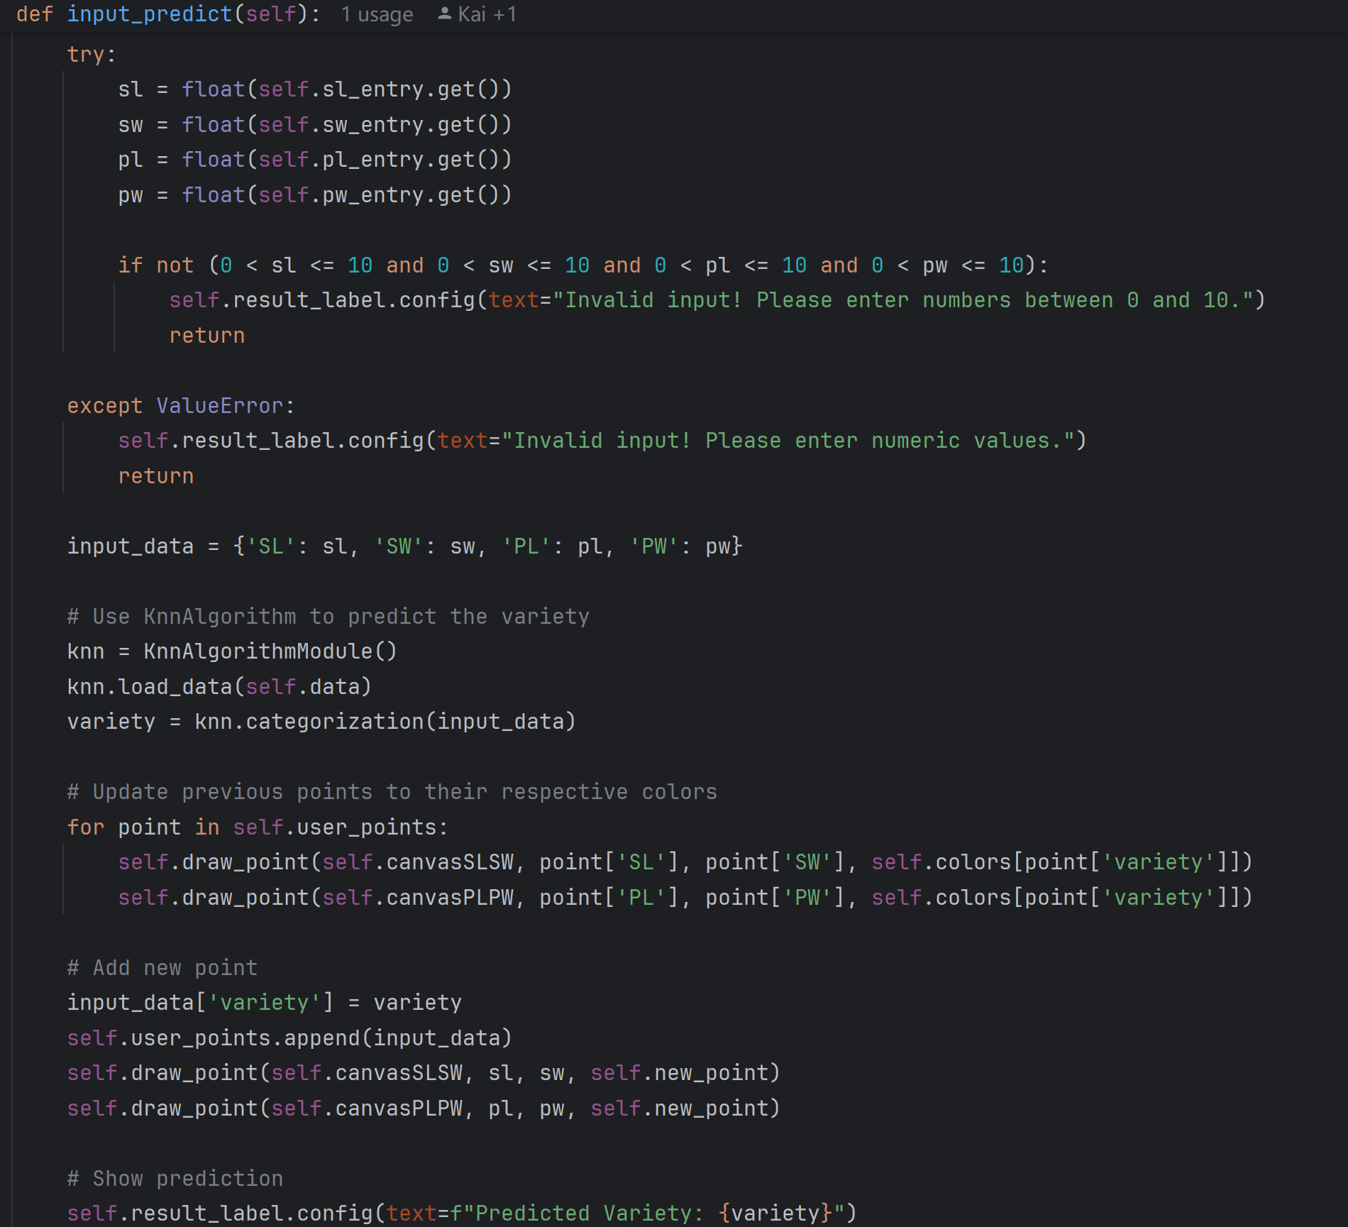
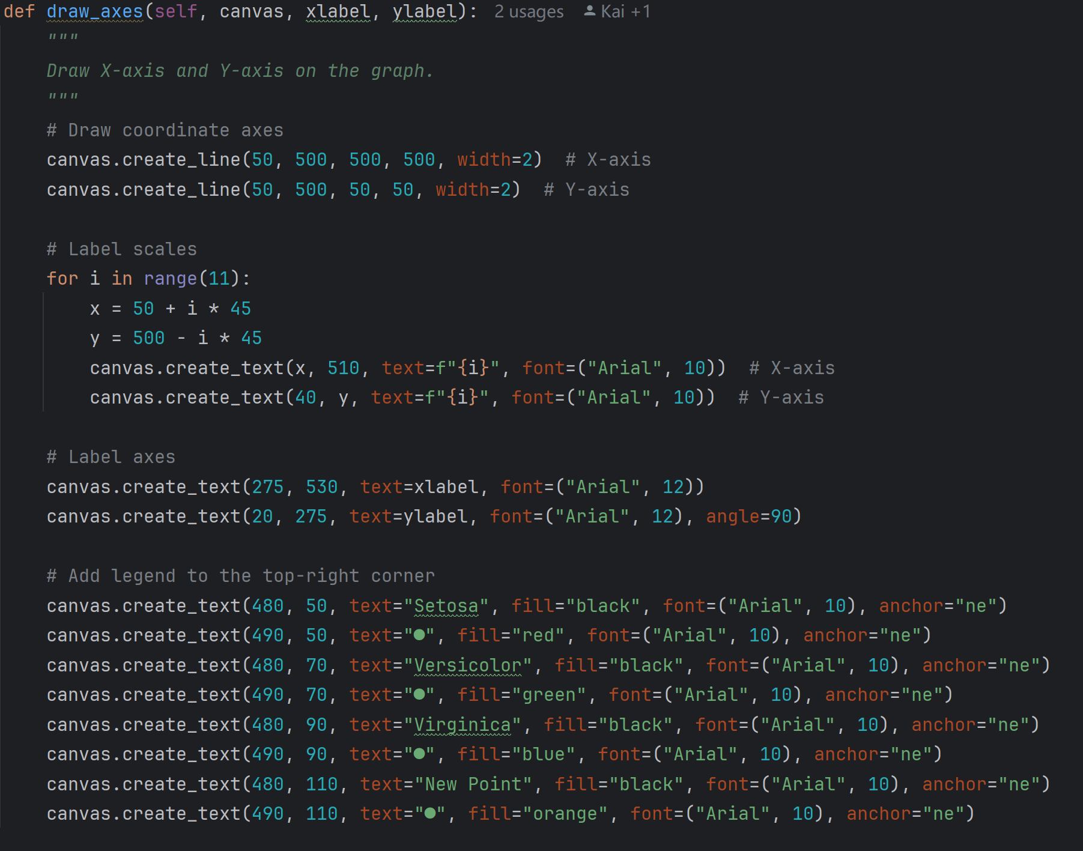
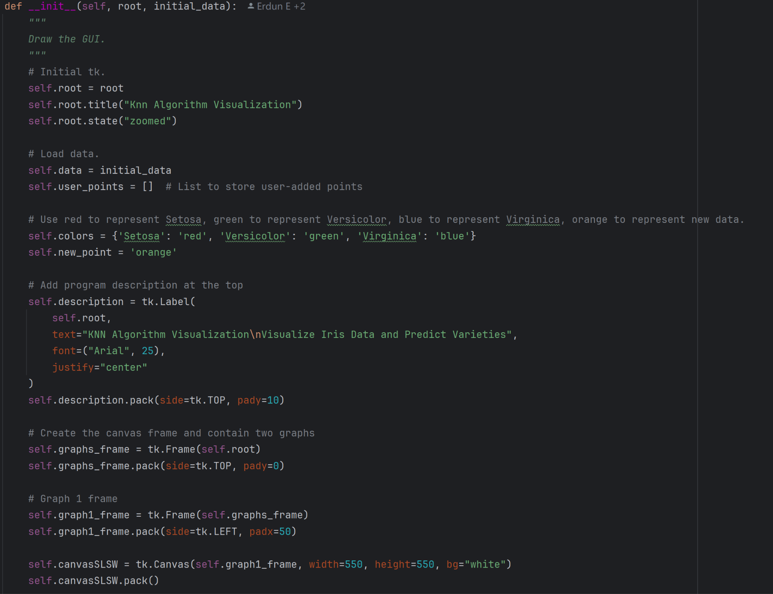
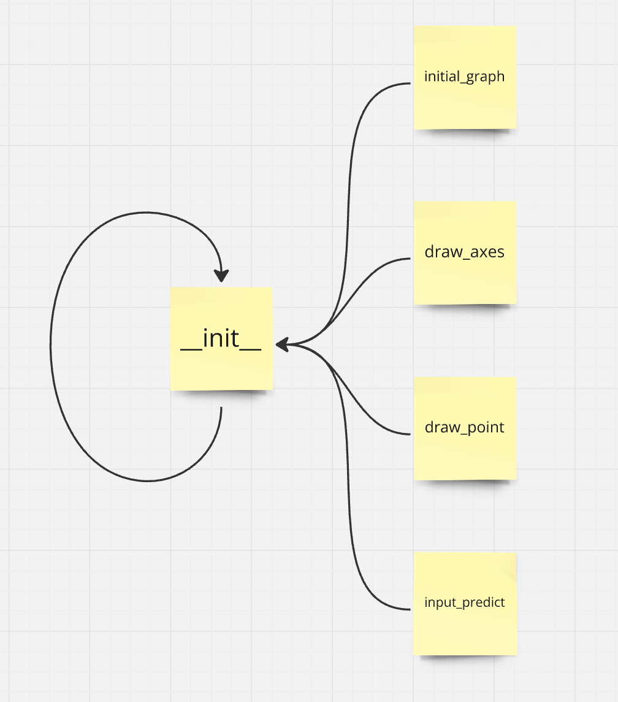
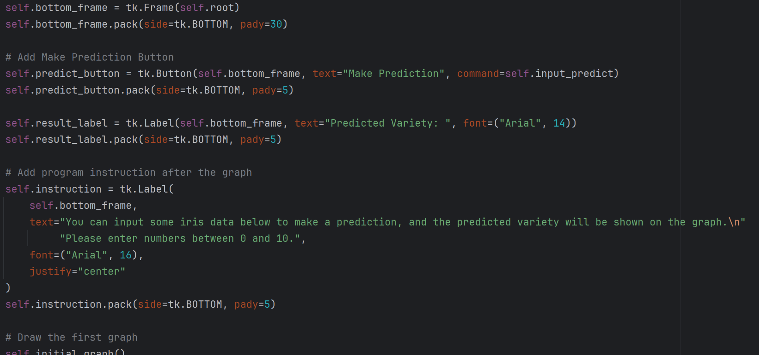
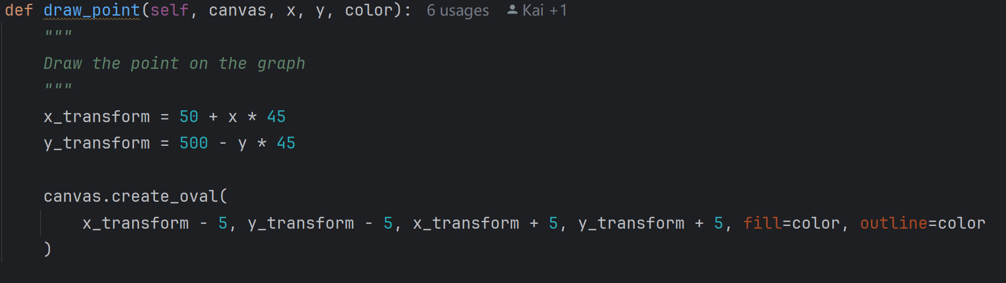
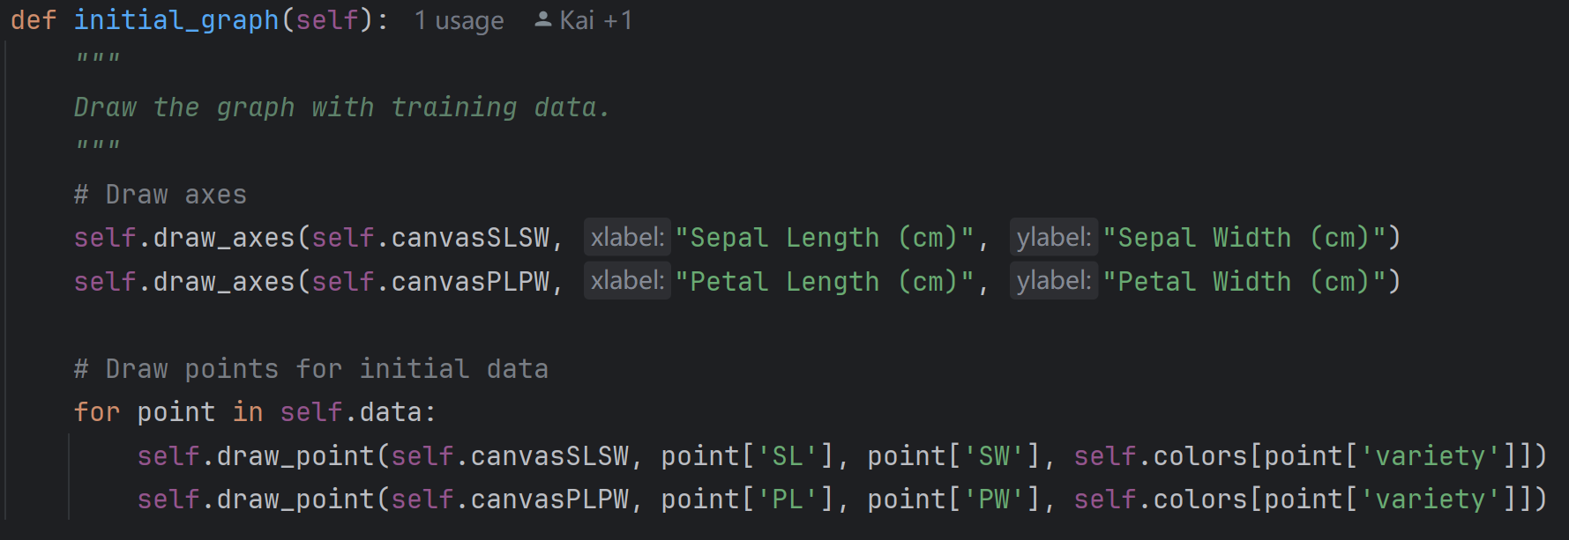
Visualizer Module
__init__
__init__
Draw the graph with all training data.
initial_graph
initial_graph
Visualizer Module
Draw X-axis and Y-axis on the graph.
draw_axes
draw_axes
Draw the point on the graph.
draw_point
draw_point
Let user input new data of iris then shows the
predicted variety on GUI and draw it on the graph.
input_prediction
input_prediction

Slide 10
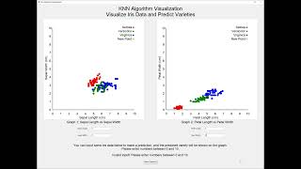

Slide 11
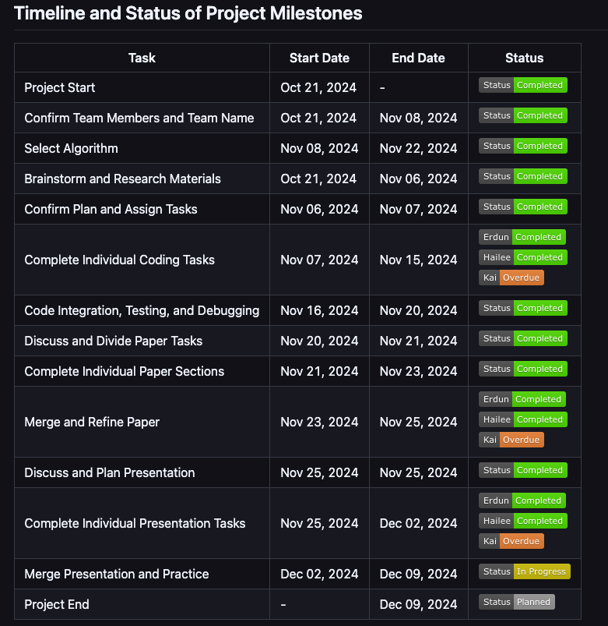
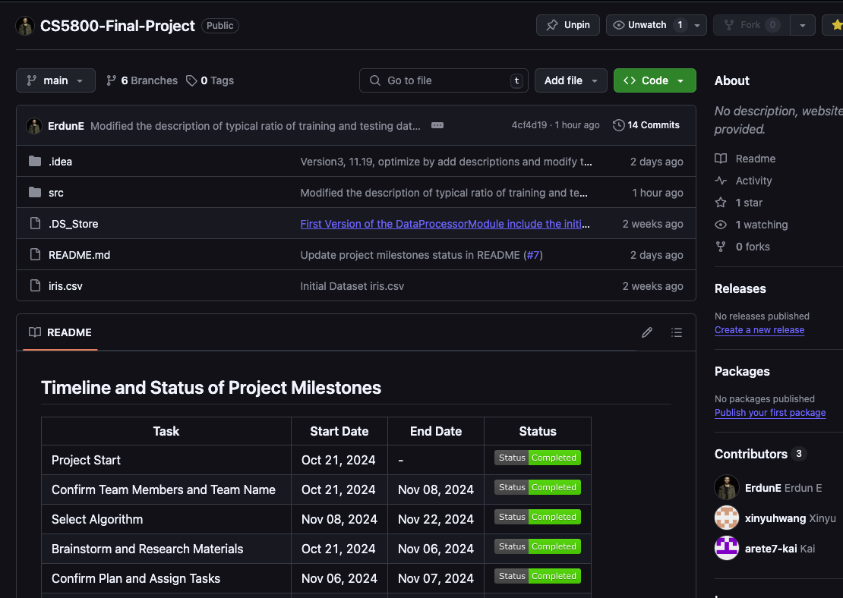
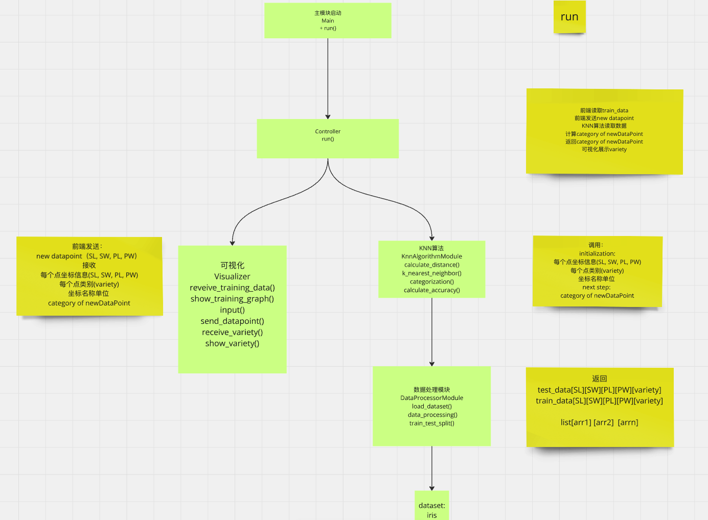
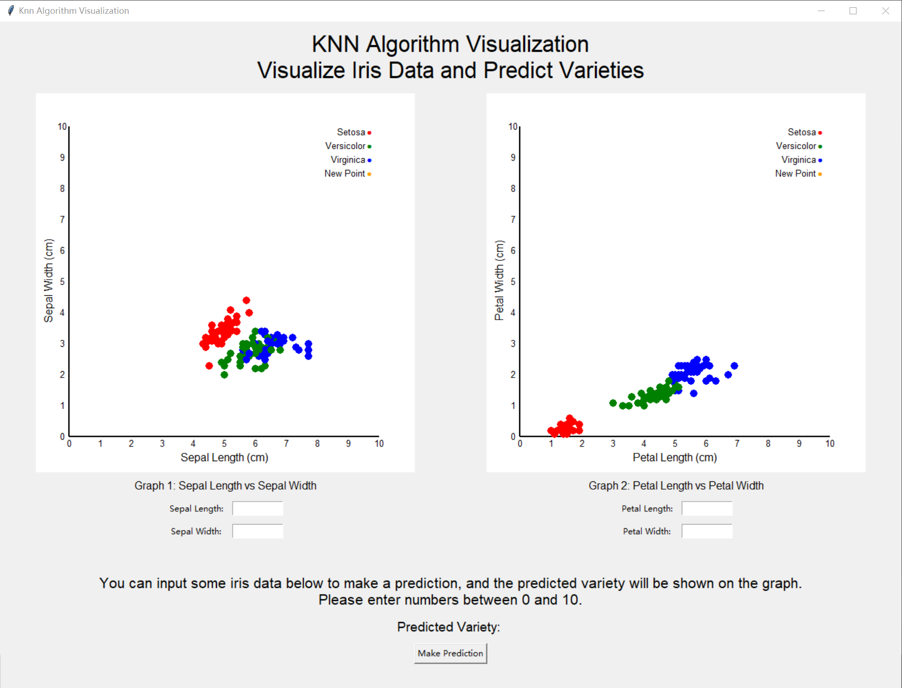
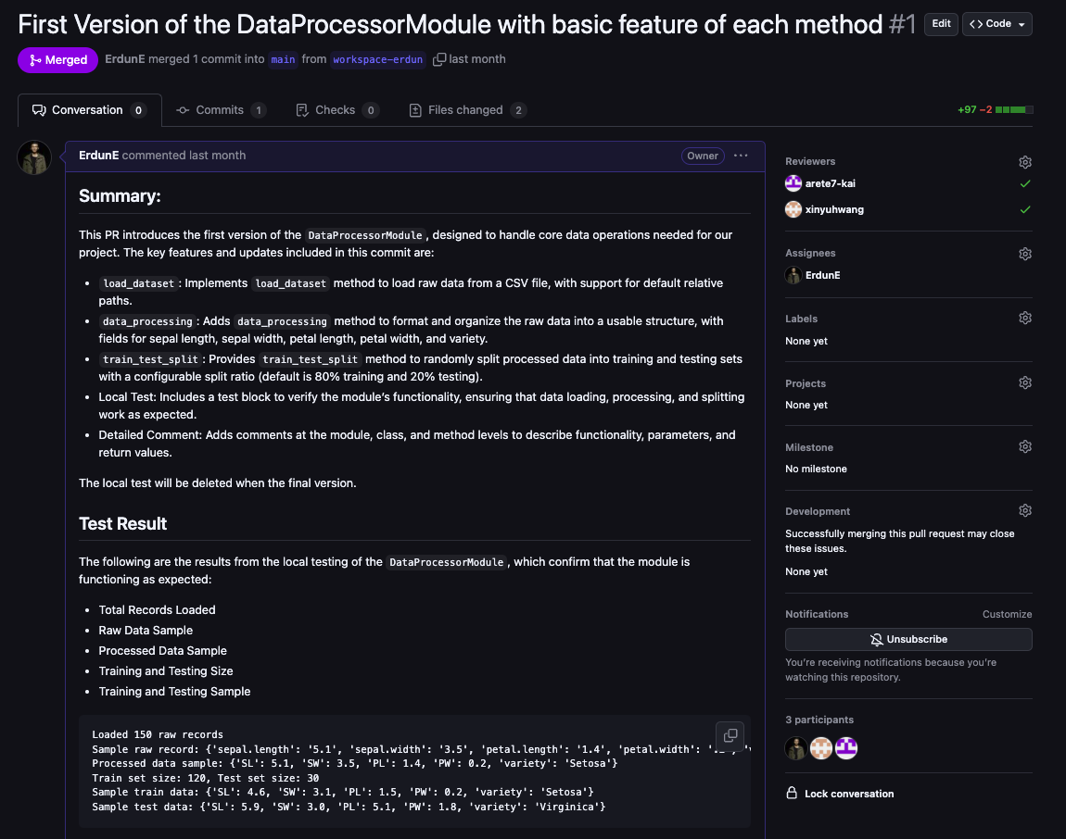
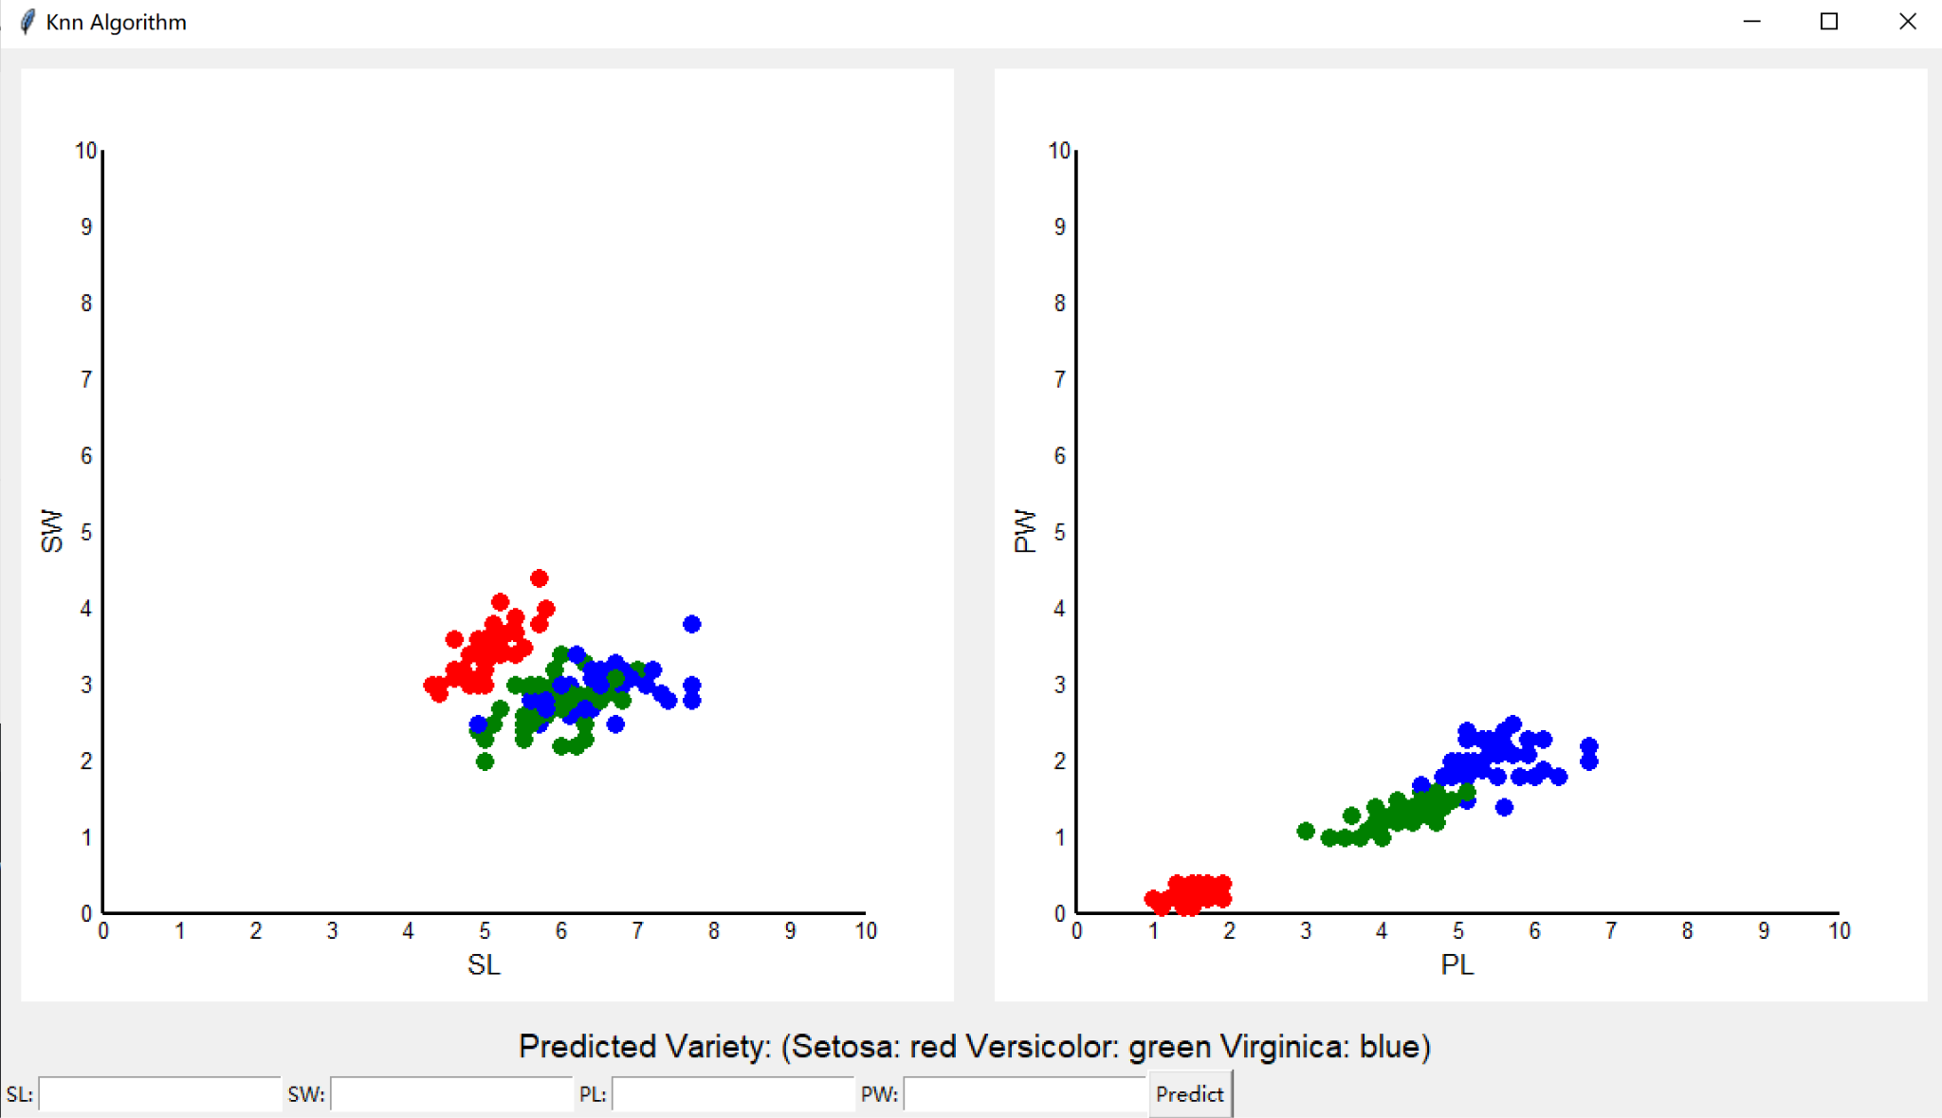
First Version
Final Version
What We Went Well?
Timeline And MileStone
Team Discussion Productive
Peer Review
Collaborate On GitHub
UI Iteration

Slide 12
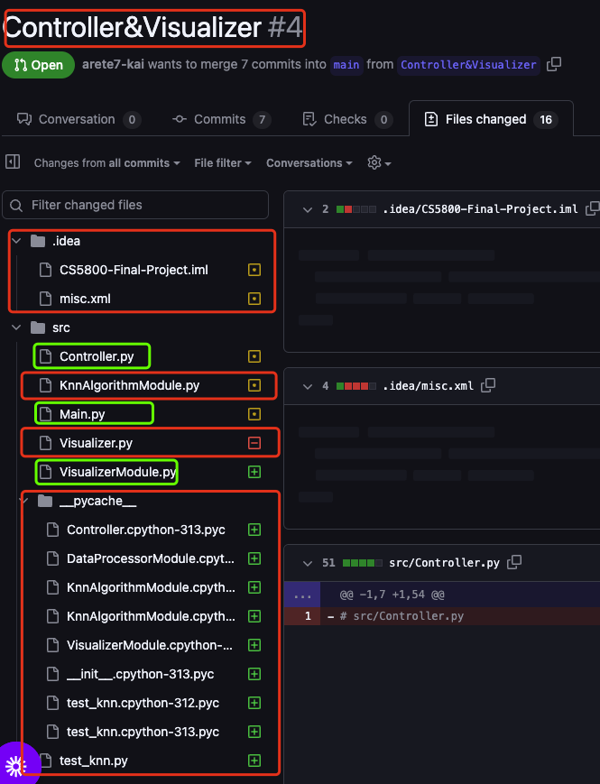
Limitations
Dataset overly narrow
Dataset designed only for Iris
﻿1. VisualizerModule.py
❌Didn't implment unit test
2. Controller.py
❌Didn't implment unit test
3. KnnAlgorithmModule.py
❗️Did unit test, need more edge cases
4. DataProcessorModule.py
❗️Did unit test, need more edge cases
Lack of Experience on Collaboration And Github
What Challenge We Meet
Insufficient Testing

Slide 13
Explore Diverse Datasets
Strengthen Team Collaboration
Optimization?
Test Thoroughly
Make the Project More Flexible

Slide 14
Citation
[Anand Manivannan]. (2024, November 20). IRIS DATA SET EXPLANATION [Video]. YouTube. https://www.youtube.com/watch?v=Orz8dlCjnnk
Find a Grave (n.d.). Evelyn Fix. Retrieved November 20, 2024, from https://www.findagrave.com/memorial/43536381/joseph-lawson-hodges
Fix, E., & Hodges, J. L. (1989). Discriminatory Analysis. Nonparametric Discrimination: Consistency Properties. International Statistical Review / Revue Internationale de Statistique, 57(3), 238–247. https://doi.org/10.2307/1403797
Lavasani, A. (2024, February 6). Classic Machine Learning in Python: K-Nearest Neighbors (KNN): Proximity-Based Predictions. Retrieved November 21, 2024, from https://medium.com/@amirm.lavasani/classic-machine-learning-in-python-k-nearest-neighbors-knn-a06fbfaaf80a
Polinowski, M. (n.d.). SciKit Wine Quality. Retrieved November 21, 2024, from https://mpolinowski.github.io/docs/IoT-and-Machine-Learning/ML/2023-01-30-predicting-wine-quality/2023-01-30/
UC Regents (n.d.). Evelyn Fix. UCB Statistics. Retrieved December 20, 2024, from https://statistics.berkeley.edu/about/biographies/evelyn-fix

Slide 15
THANKS
THANKS

